Slide 1

Eclipse Tutorial
Installation and Running First Program on Eclipse IDE

Slide 2
What is Eclipse IDE
IDE stands for Integrated Development Environment.
With Eclipse you can write your java programs much faster and execute them with a push of a button. But Eclipse is much more. The plug-in architecture gives you the ability to constantly add the development tools you need.

Slide 3
Installing Eclipse
Installing eclipse is easy and straightforward. If you don’t have Java JDK installed on your computer already, please install it now.
Now go to http://eclipse.org/downloads/. Locate “Eclipse IDE”. You must download the Eclipse version corresponding to your Java version.
For example if you have installed Java x64 Bit, than take the Eclipse x64 Bit and the x32 Bit version otherwise.

Slide 4
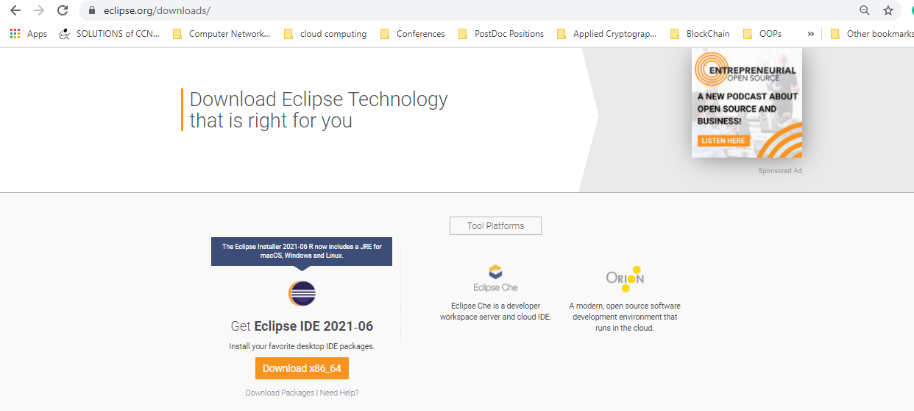
Downloading
Go to http://eclipse.org/downloads/.
Download “Eclipse IDE 2021-06”.
Click on download button for dowloanding exe file for installing it on Windows.
Note: You have to download the corresponding file for installing it on Ubuntu OS. The same URL will direct you to download the corresponding version on Ubuntu OS.
Fig 1: Downloading URL for Eclipse IDE

Slide 5
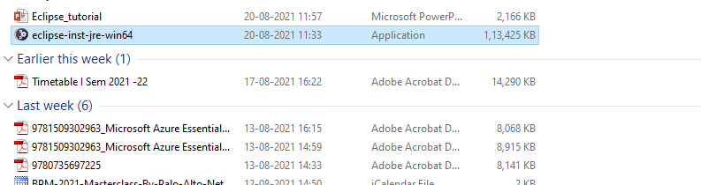
Start Eclipse
Once the downloading is completed, start installing it by double clicking it on the downloaded file.
Follow the instructions and complete the installation.
Fig 2: Start Eclipse by Clicking .exe

Slide 6
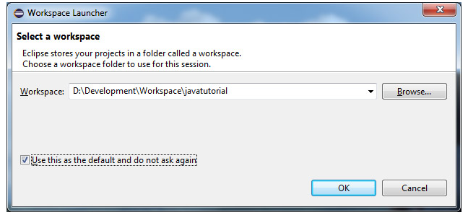
Workspace
Open the Eclipse IDE from Windows Start button.
Now you have to choose a Workspace for your projects.
A Workspace is a folder location on your hard-drive, where Eclipse stores your java projects.
For example, I will use D:\Development\Workspace\javatutorial as main folder for all my laboratory projects and tutorials examples.
Fig 3: Workspace Launcher

Slide 7
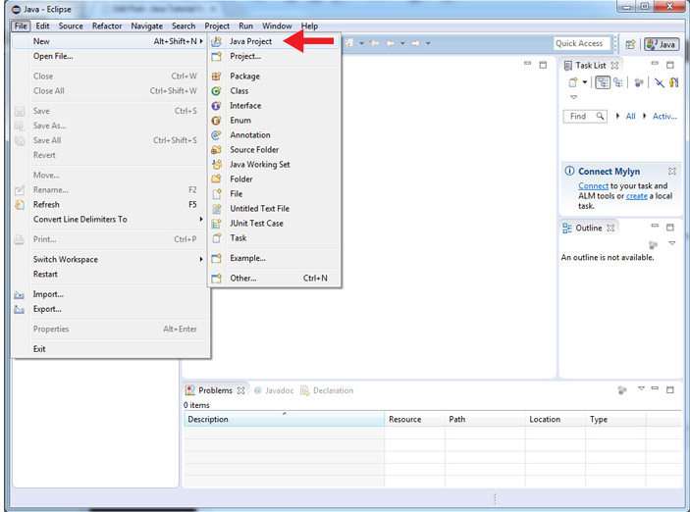
Creating Java Project with Eclipse
Java code is organized in projects in Eclipse.
Start with our first project. Click on File -> New -> Java Project
Fig 4: Start Java Project.

Slide 8
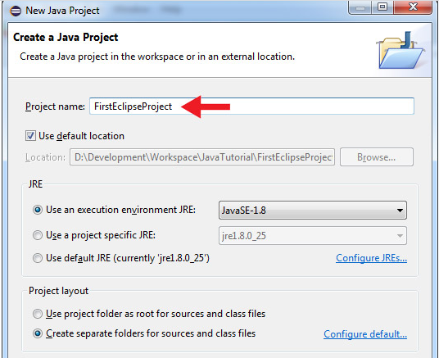
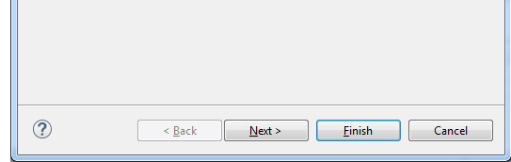
Create a Java Project
Give your project a name. I will use “FirstEclipseProject” for this example.
Click on “Finish” button.
Note: You can also click on Next button, but you will have to uncheck the “Create module-info.java file” and then you can click finish button.
Fig 5: Finish Java Project

Slide 9
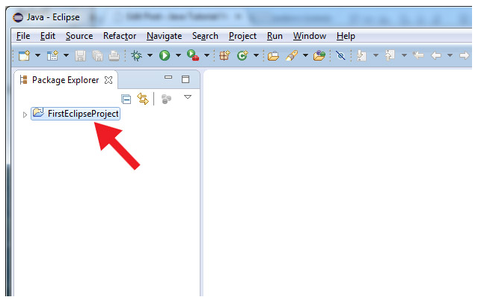
Eclipse Project
Eclipse will create the structure of the project for you.
Now you will see your new project in Package Explorer on the left side of your screen.
Note: If the Package Explorer is closed mistakenly or not opened for any other reason, you can get it by clicking on window menu on toolbar as mentioned below.
Window → Show View → Package Explorer
Fig 6: Project location in Navigation space

Slide 10
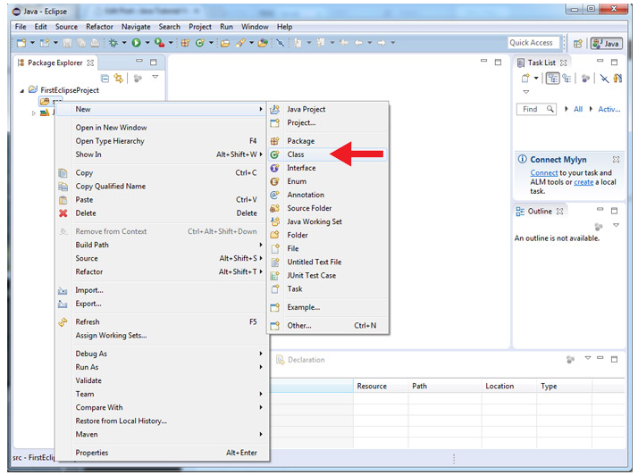
Expand the project by clicking on project name.
Right click on the “src” folder, than go to New -> Class
Fig 7: Select Java Class

Slide 11
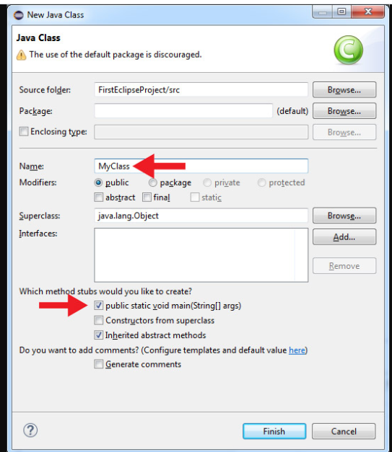
Assign class name
Enter name for the new Java class.
I will use “MyClass” as a name for this example.
I will also check the box “public static void main(String[] args)” to let Eclipse create a main method for me.
Note: You can also uncheck “public static void main(String[] args), but you will have to add it manually later. This is required based on the needs of the programs and project.
Fig 8: Assign class name

Slide 12
Java Program
Eclipse has created a new class for us with a main method. You can add the statements as per the problem.
public class MyClass {
public static void main(String[] args) {
System.out.println("Programming with Eclipse is easy!");
}
}

Slide 13
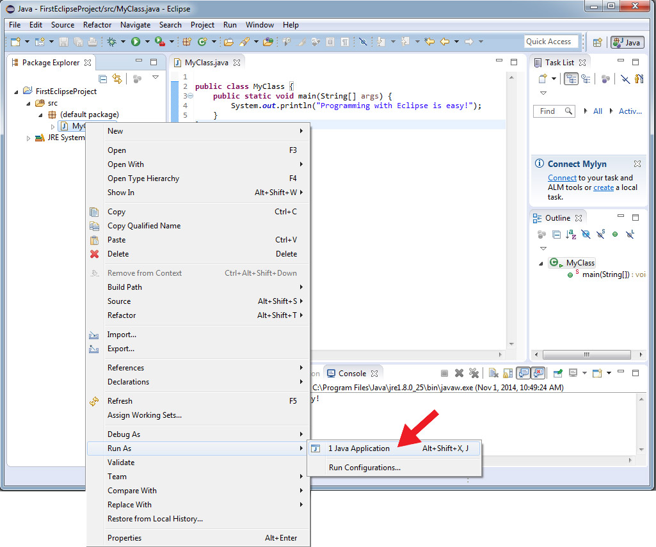
Save and Run
Save your work. Right click on “MyClass.java” in Package Explorer then, click on Run As -> Java Application
Fig 9: Save and Run Java Program

Slide 14
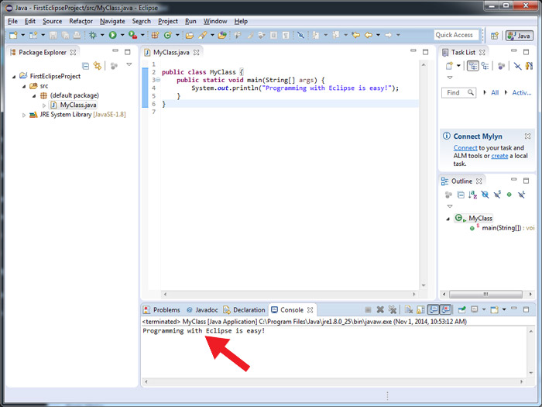
Result
In console tab you should see the result of your program
Fig 10: Result Console

